Slide 1
Woodloch Springs Vacation Rental Homeowner Meeting
March 20, 2021

Slide 2
Woodloch Updates
Brad Kiesendahl

Slide 3
Ground Rules and Introductions
Meeting will be approximately 1.5 hour
Zoom Format—Enter questions into the Chat Section—answer at the end of the meeting
Who is in the Room

Slide 4
Looking Back
Optimism abounded at 2020 Meeting
Pandemic and our Initial Response
Staff Efforts—Outreach and Concern
Re-opening process—reinventing the Woodloch Experience
Creativity—Long Term Rentals, Smaller Families, Utilization of Home by VR owners
Election and Racial Unrest
Roller Coaster from June-December

Slide 5
Looking Back
Guest Feedback and Reputation
Exposed lots of New People to Woodloch
Real Estate Boom
The Lodge at Woodloch shared a similar path
Confirming our Why?—What Woodloch Means to People

Slide 6
Economic Impact
Significant losses
Pines Occupancy declined by more than 50%
Springs Occupancy declined by more than 10%
Banking Relationship
Qualified for the 1st round of PPP
Political Efforts and Lobbying for Woodloch and Travel Industry
Unable to qualify for 2nd Round of PPP
Capital Expenditures—limited but still necessary (ice cream, fire pits, etc.)

Slide 7
Current Status
Pa Capacity and Travel Restrictions
Vaccination Efforts
Current operating levels—hopes for Summer
What to expect from your WL experience
Short term and long term effects of pandemic on travel
Balance-Safety, Experience, Reputation, Profitability

Slide 8
Program Updates
Brooke James

Slide 9
2020 Journey
Expectations started high in 2020
Reaction to business closing
Pandemic paved a new path
Woodloch Springs Guest Homes showed early opportunity
Hiring a Vacation Rental Manager

Slide 10
Vacation Rental Manager
Proactive Approach
Spot Checking Vacation Rental Homes on a daily basis
Open communication with Vacation Rental Team
Continues to build strong relationships with team
Communicating with home owners as much as possible
Connecting with home owners while on property

Slide 11
2020/2021 -Inspection reports
Inspections are in the process of being rolled out
Our approach this year, took into consideration the decline in rentals due to COVID -19
Upcoming projects/ updates are noted for planning purpose
Goal is to continue to maintain and make necessary improvements to keep your homes attractive to our market

Slide 12
Feedback, Reviews and Marketing

Slide 13
Marketing VRH through a Pandemic
Vacation Rental Homes Focus for Marketing in 2020
Home page and Email consistent presence
Several Options to chose from
Short Term, Long Term, Golf, Ski and Stay Package and much more
Have flexibility with dining options, or cooking in home
Catering menu from The Clubhouse
Overall attractive, unique and safe option during the national pandemic

Slide 14
Trip Advisor
Woodloch Springs rental home
LOVED it! They allow dogs, and the set up was fantastic! We felt safe during covid, the food was delicious (take out from the overlook) and the drinks were even better! From reservations with Carol, to the massage I had at The Lodge with Laura, to the service and smiles, we relaxed and enjoyed every second. Thanks Woodloch for giving respite during a tough time in our world!
Read less

Slide 15
Trip Advisor
Vacation
First let me start my saying, I am a registered nurse, I saw first hand the devastation that Covid-19 has caused in this country so I cancelled my vacation this year (cruise), but I realized that we needed to get away. I was lucky to find Woodloch resorts in PA. We stayed at Woodloch Springs on the bed and breakfast plan, it was amazing. I would be remiss if I did not mention our lodging at the Springs. The house was simply gorgeous, fireplaces, cathedral ceilings backing up to a spectacular golf course, very impressive. There were 10 of us in our family and we had more than enough room to spread out. All in all, we are a cruise and Caribbean all inclusive family, but Woodloch surprise us all. I did not know that we could have such a fabulous vacation so close to home.

Slide 16
Update from Vacation Rental Manager
Tara Carrubba

Slide 17
Proactive Approach
Daily spot check of rental homes
Ongoing communication with maintenance & housekeeping
Managing the needs & expectations of other VR team managers
Evaluating procedures and coordinating with VR managers to work smarter & more efficiently
Establishing relationships with owners; focusing on increased communication

Slide 18
Annual Inspection Reports
Inspections are completed and have been shared with owners
Requesting owners schedule time while on property for walk thru with VR Manager to review required and recommended items
Working with owners to prioritize the recommended & required improvements / Identifying the effects of the pandemic on owner’s ability to reinvest to complete required improvements
Scheduling projects around reservations so as to not impact potential rental income
Some reports include “Projected Items” (roof, HVAC, etc.) to address the aging infrastructure of the homes
Ownership is independent of rental income

Slide 19
AWA Standards
AWA is a standard established by Woodloch to create consistency yet allowing owners to individualize their homes.
3 main standards include: flooring, painting and wall coverings.
Understanding the separation of ownership and AWA standard
We do permit owners to deviate provided the owner: Uses an interior decorator Has a decorating plan approved by Woodloch There is extra material in the event a repair in needed

Slide 20
Expanded AWA Standards
Depersonalization of Home / No Seasonal Decorations
Guidelines on lamps/artwork/accessories
Hard surface flooring on 1st floor in common areas
Stainless steel kitchen appliances
Countertops: quartz/granite/corian
Quality roll-up shades on windows
Limited to one twin bedroom and no bunk beds
King-size bed in master bedroom
TV’s – Samsung is the preferred manufacturer/flat panel/32” in all BR’s and 42”+ in LR & FR.
Option to deviate with a designer approved by Woodloch

Slide 21
Annual Preventative Maintenance
Your yearly maintenance fee covers preventative maintenance of the following components in your home:
FIREPLACE CLEANING
HVAC (twice annually)
GUTTER CLEANING
Any repairs or replacements that are deemed necessary as a result of the PM will be completed at the owner’s expense. The Vacation Rental Manager will contact the owner to discuss.

Slide 22
Accomplishments
WiFi Upgrade: IT dep’t replaced an ineffective guest wireless network architecture with individual networks per rental unit.
Department Coordination – synergy!
Evaluated & revised maintenance work order and billing procedures
Enhanced internal workflows
Improved Preventative Maintenance tracking & scheduling; dedicated maintenance coordinator for program
More estimates completed & owner approved at this point in the year than in previous years

Slide 23
Looking Ahead
Revisiting the inspection reports in the Fall to address the required items that may have been put “on hold” until after the summer rental season
Striving to achieve consistency in the rental accommodations
Continuing to look for ways to improve our system so we do not miss any areas of improvement that may be necessary

Slide 24
Update from Revenue Manager
Amy Beilman

Slide 25
2020 Final Income/Occupancy
 | 2018 | 2019 | 2020
Occupancy | 40.8% | 37.4% | 33.6%
Income | $2,421,319 | $2,314,286 | $1,566,169
% Change of Income | +3% | -4.4% | -32.3%

Slide 26
2020 Review
Through 80 days of closure and beyond, the Vacation Rental Homes were a place of safe respite for many of you and in turn we parlayed that into an opportunity for our guests to have that too. (Long Term Rental Program)
While, the occupancy percentage is only 3.8% behind –all room nights are not created equal.
It’s a mix of personal usage (no income), long term rentals (longer stays but only 1 unit), and regular business.
Due to capacity restrictions, occupancy did not hold the same weight as normal - guest counts were priority.

Slide 27
2020 Income Review
Early projections were that income would fall about 50% behind, but through our strategic approach we were able to narrow that loss for the program to 32.3%. Individual home performance varies.
Highlights:
Demand – Drive To Market; Private Homes
Long Term Rentals
Limited Rate Resistance
New guests (turned into repeat already!)
Challenges:
Capacity
State Imposed Restrictions Impact
Generational Travel Discouraged (impacted larger homes the most)
Cancellations from our loyal, repeat guests

Slide 28
Looking ahead… 2021 Forecast
While we are forecasting 2021 occupancy to be behind 2020 at 32.5% (235 room nights behind); income is not expected to be behind 2020.
Some challenges we factored in:
Capacity Restrictions vs Guest Expectations
Return of Expanded Travel… ie- air travel
Limited Weddings and Corporate Travel
However, 2021 is starting better than forecasted.
Some positives:
February the program income was up 8%; also up over our projections to the bank
WLS is pacing ahead of 2020 BEFORE pandemic hit for the entire year.
Loosening of travel restrictions sooner than expected
Interest still strong with Long Term Rentals
Phones are BUSY! Waiting lists are BACK!
Early sales show stronger than ever results; peak dates still are peak but the shoulder nights getting big boosts.
Price Integrity from 2020, helps a stronger 2021. (Long term goals vs short term gains!)

Slide 29
Jan/Feb 2021 - Income/Occupancy
 | 2019 | 2020 | 2021
Occupancy | 21.6% | 30.1% | 37.3%
Income | $158,667 | $234,133 | $239,973
% Change of Income | -10% | +48% | +2.5%

Slide 30
What affects my rent?
Guest Requests:
Location
Specific number of bedrooms and baths
Screen porch, large deck, bed types, views, etc
Personal preference to move after in the unit
Groups and reservations of friends requesting houses next to each other
Overall freshness of décor & furnishings and living space
Last minute cancellations (Covid / Covid Exposure)
Owner usage on high demand times
Maintenance/construction issues
Distribution Challenges
Handicap
Pet Friendly
Volume of Reservations

Slide 31
We make every effort to spread rentals evenly, but in the end we accommodate our guests’ preferences rather than lose the reservation or disappoint a guest.

Slide 32
Springs vs Pines – Redwood Comparison
Cost to guest for 1 week in summer with 3 families of 4 sharing Redwood category home, including tax and 15% gratuity:
Redwood / Springs Non American Plan: $11,458
Southwoods Pines American Plan: $32,041
Difference: $20,583

Slide 33
Springs vs Pines – Hemlock Comparison
Cost to guest for 1 week in summer with a family of 6 in a Hemlock including tax and 15% gratuity:
Hemlock / Springs Non American Plan: $8,583
Tallwoods Pines American Plan: $17,108
Difference: $8,525

Slide 34
Long Term Rental Program
40 Rentals - $428,070
27 for 2020 … base rate: $267,570
13 so far for 2021 … base rate: $167,600
Fun Facts:
2 renters purchased homes in WLS
1 renter purchased a home in surrounding area
Summer 2021 already has one repeat renter
Throughout the year, we have had 10 extensions – and 2 repeat bookings.
I book and evaluate all inquiries… verify LTR vs Repeat Guests.
Highest requests – Pet Friendly and Screened-in porches; and individual home photos for decision making.

Slide 35
Airbnb / Travelzoo
Early 2020 – we tested pilot programs with Airbnb and Travelzoo. Cut short due to pandemic. Well received but hard to manage on our end.
Woodloch’s Vacation Rental Homes need to be present where the guests are booking/shopping.
Are the Airbnb’s in the community competition?
Yes – at times; depending on the renters price point and expectation of use
No – use of Woodloch Pines is not included
Reminder: You cannot privately rent your home to guests or list your home on these platforms.

Slide 36
Wrap Up
Personal Usage – make sure you’ve booked your travel for the remainder of 2021; specifically your summer or holiday travel. Many normal plans were altered in 2020 and may not have been carried over to 2021.
Guest Counts - Please send counts when you are using your home. You’ll never be turned away! We just want to plan accordingly.
THANK YOU

Slide 37
Marketing Update
Rory O’Fee

Slide 38
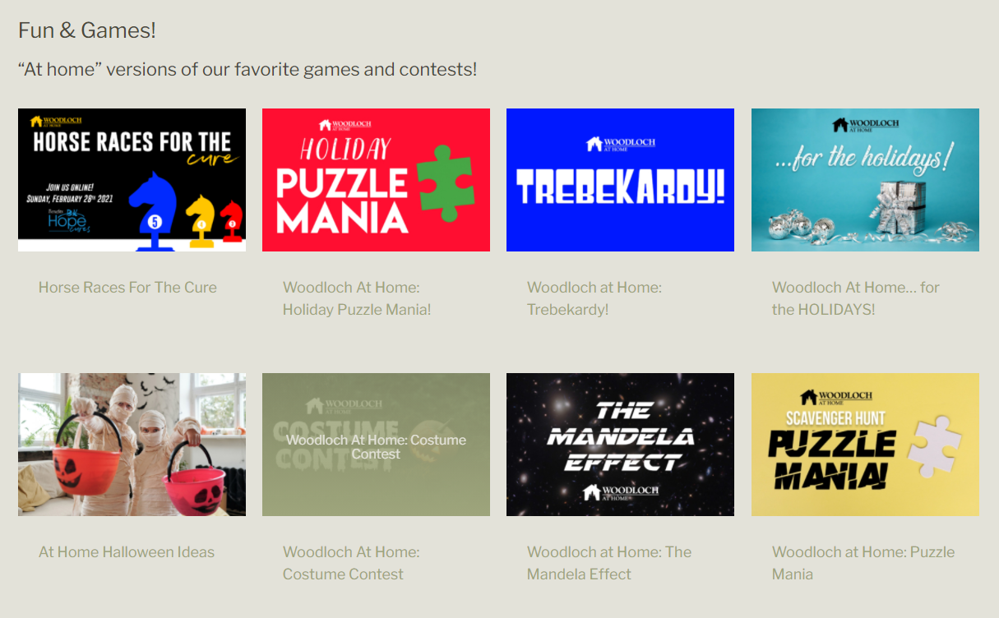
Things took a turn…
Woodloch@Home
Community Outreach

Slide 39
We’re All In This Together

Slide 40
Messaging Shift - Reopening
All In This Together to Resort Responsibly
Galvanizing of the Brand

Slide 41
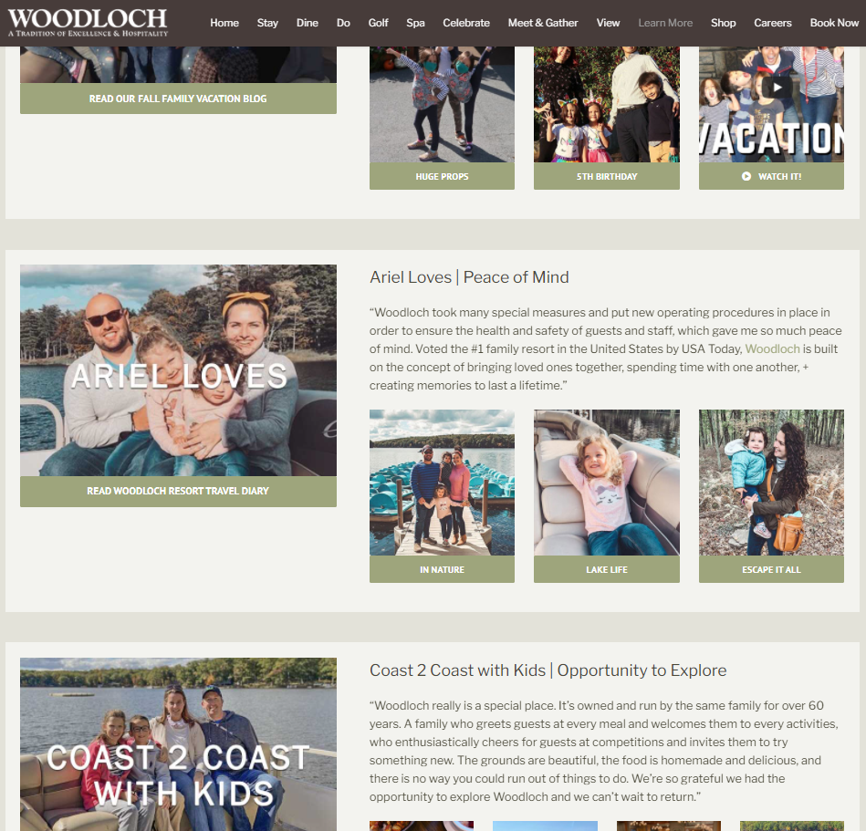
Influencers
Hosting 5-7 Influencers/mo
Home page presence
Social Media
14,000 views

Slide 42
Earned Media and Influence
Influencer outreach leads to earned media

Slide 43
Brand Growth and A Fresh Start
National Plan Your Vacation Day / TravelZoo
Web Traffic Growth (Jan – Mar, up 35% YOY)
Google Digital Advertising

Slide 44
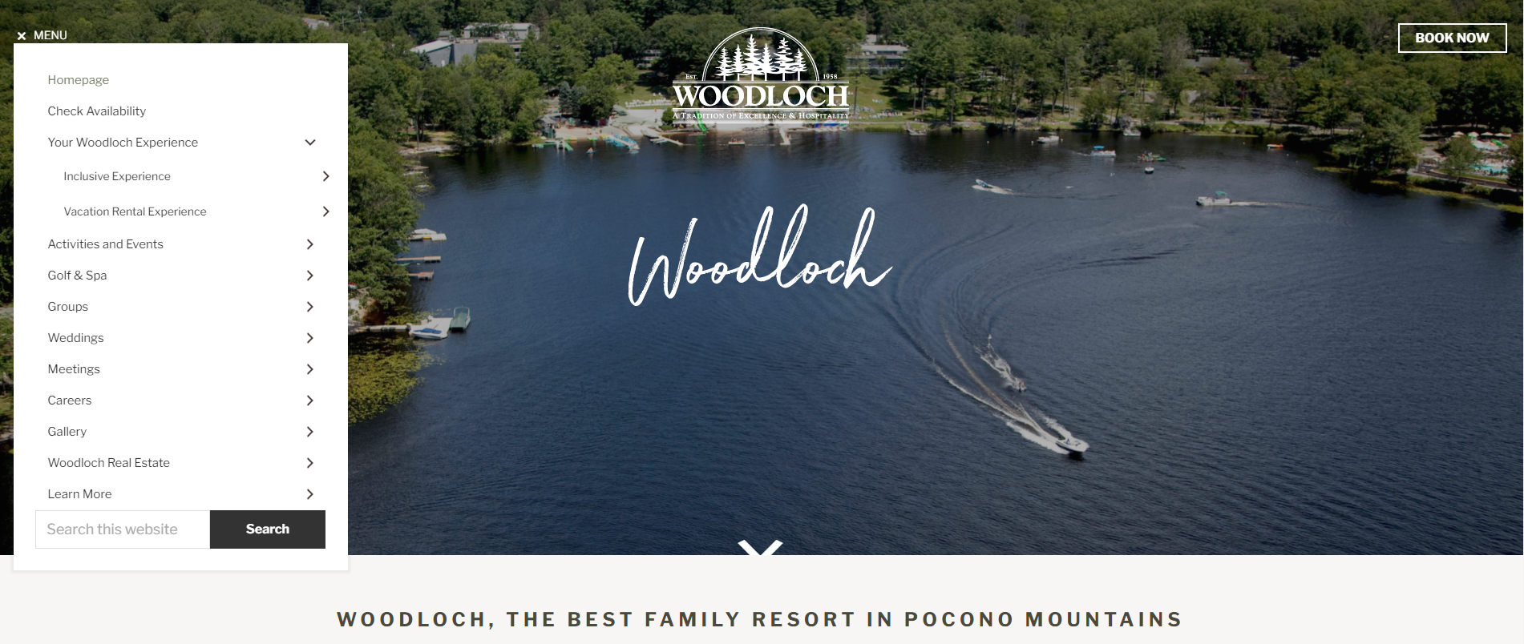
What’s Next?
Step 1 - The New Woodloch.com

Slide 45
The New Woodloch.com
Home Page
Special Statement
Vacation Rental Experience
Long Term Rentals

Slide 46
What’s Next
Connecting Marketing to Customers
Track / Metasearch
Super Content Marketing
UGC
Potential Department Growth

Slide 47
Questions?

